Slide 1
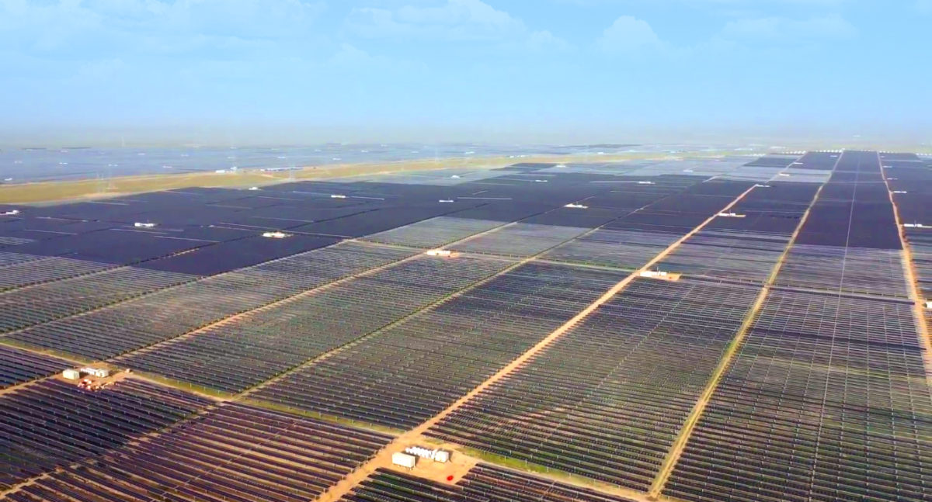

Slide 2
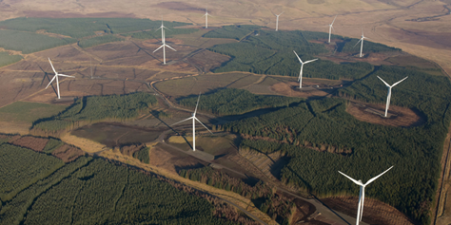
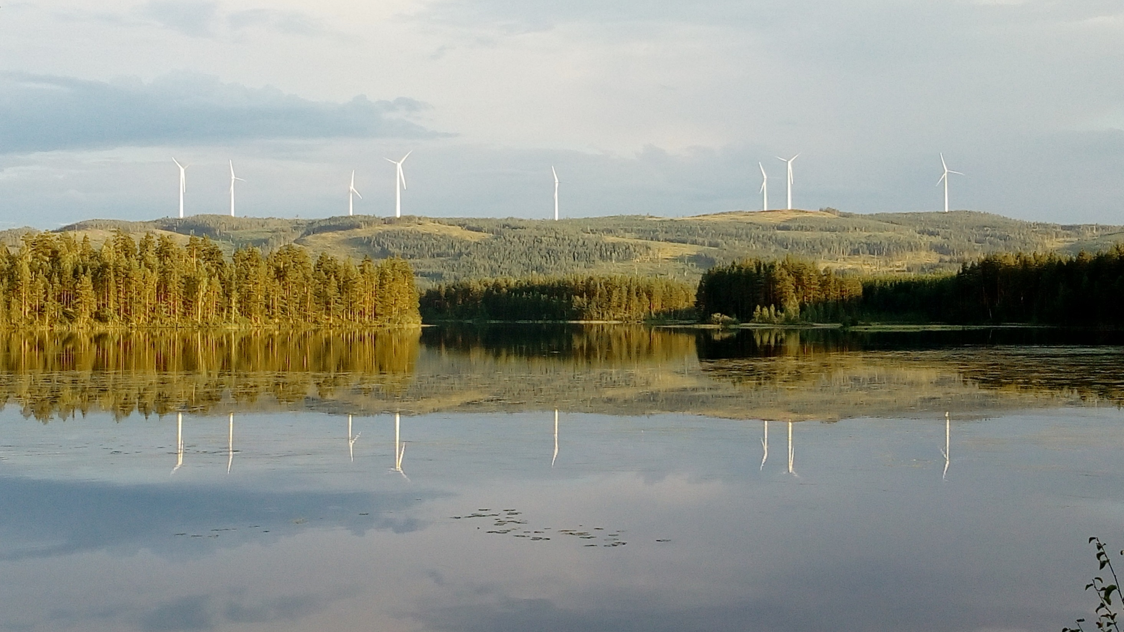
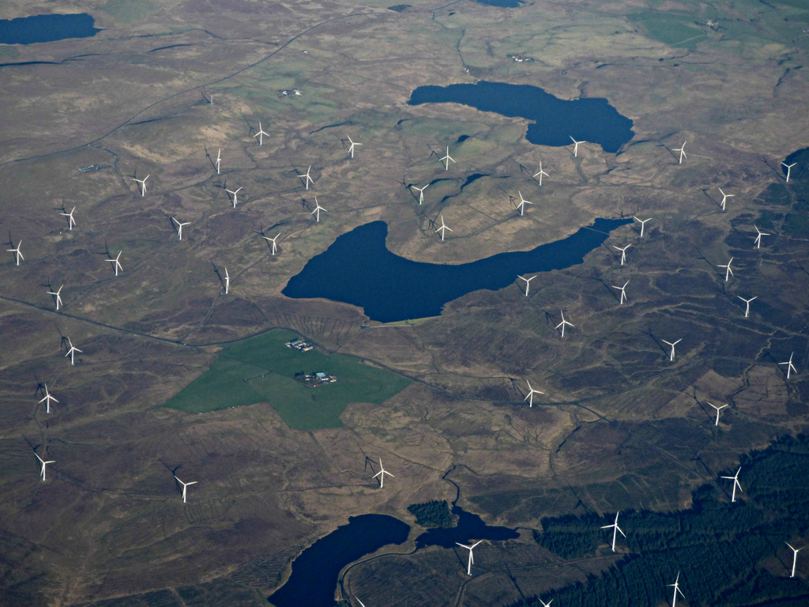

Slide 3
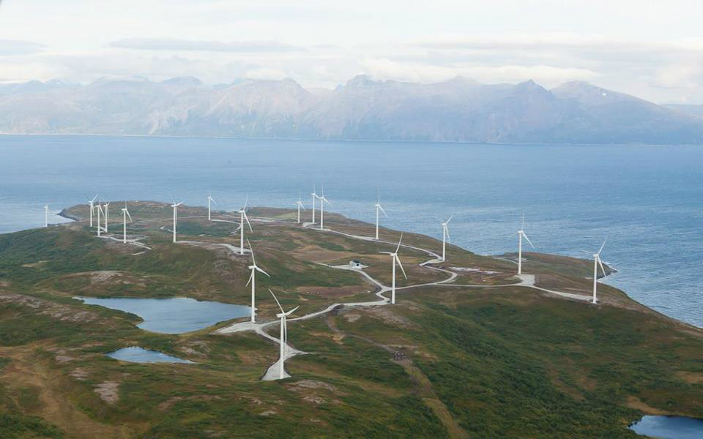
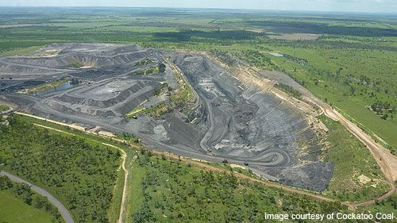
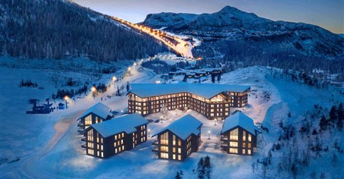
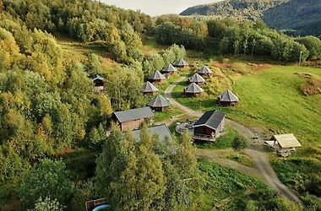

Slide 5
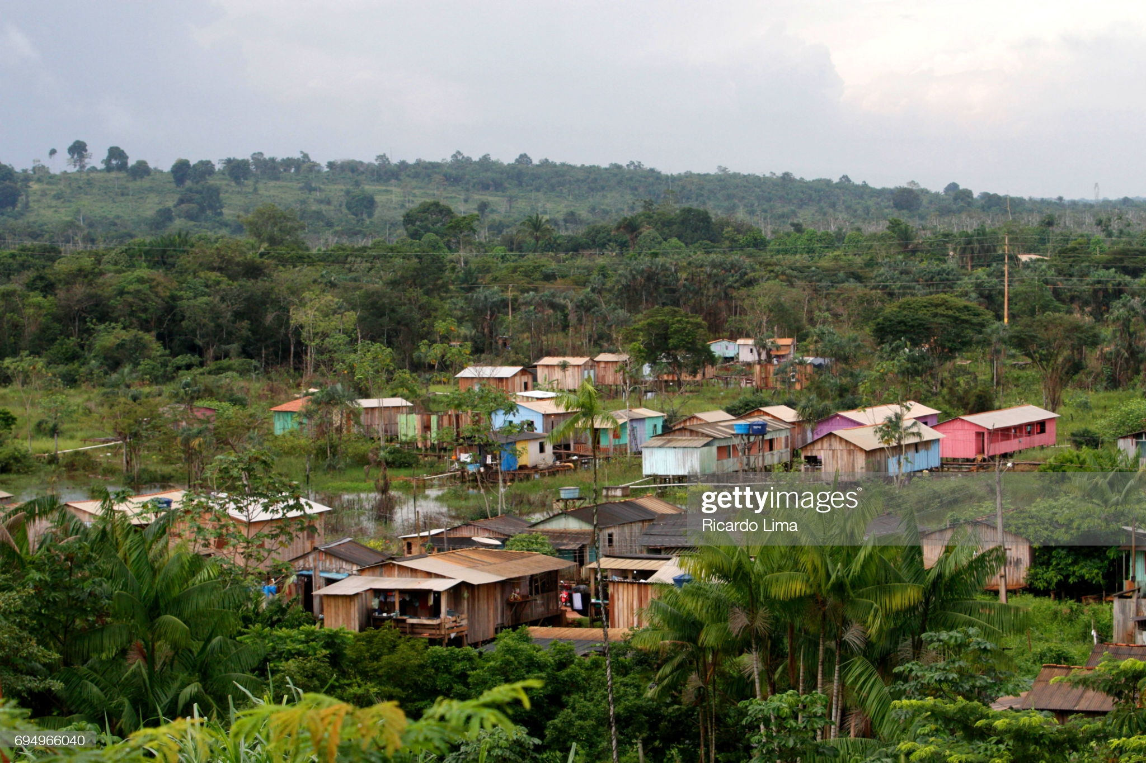
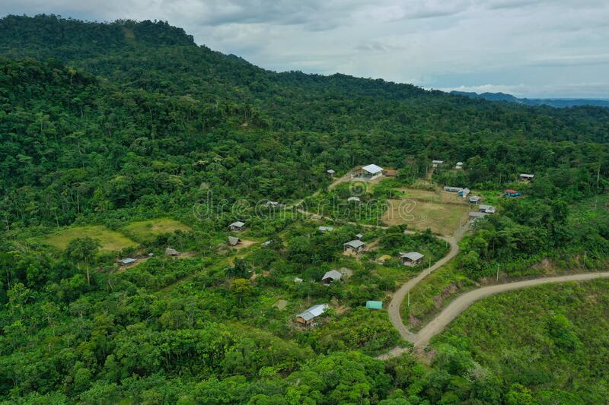
Shantytown In Altamirapabrazil High-Res Stock Photo - Getty Images
aerial-view-indigenous-community-amazon-ecuador-207850836.jpg (800×533) (dreamstime.com)

Slide 6
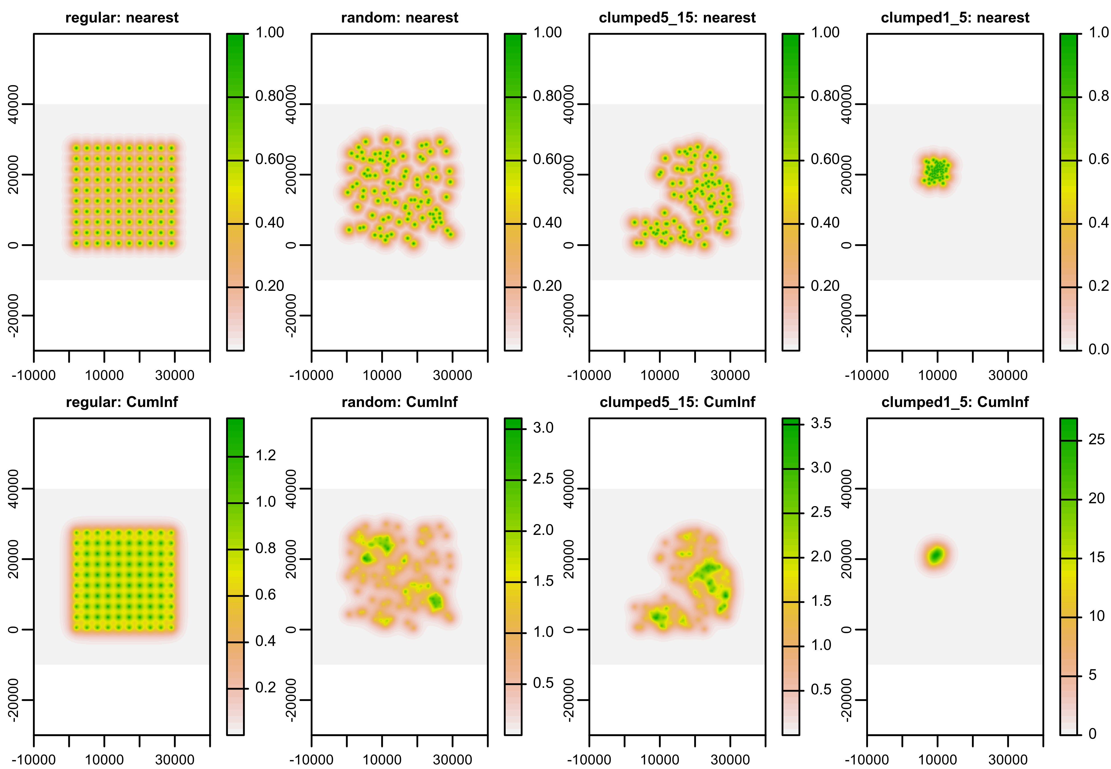
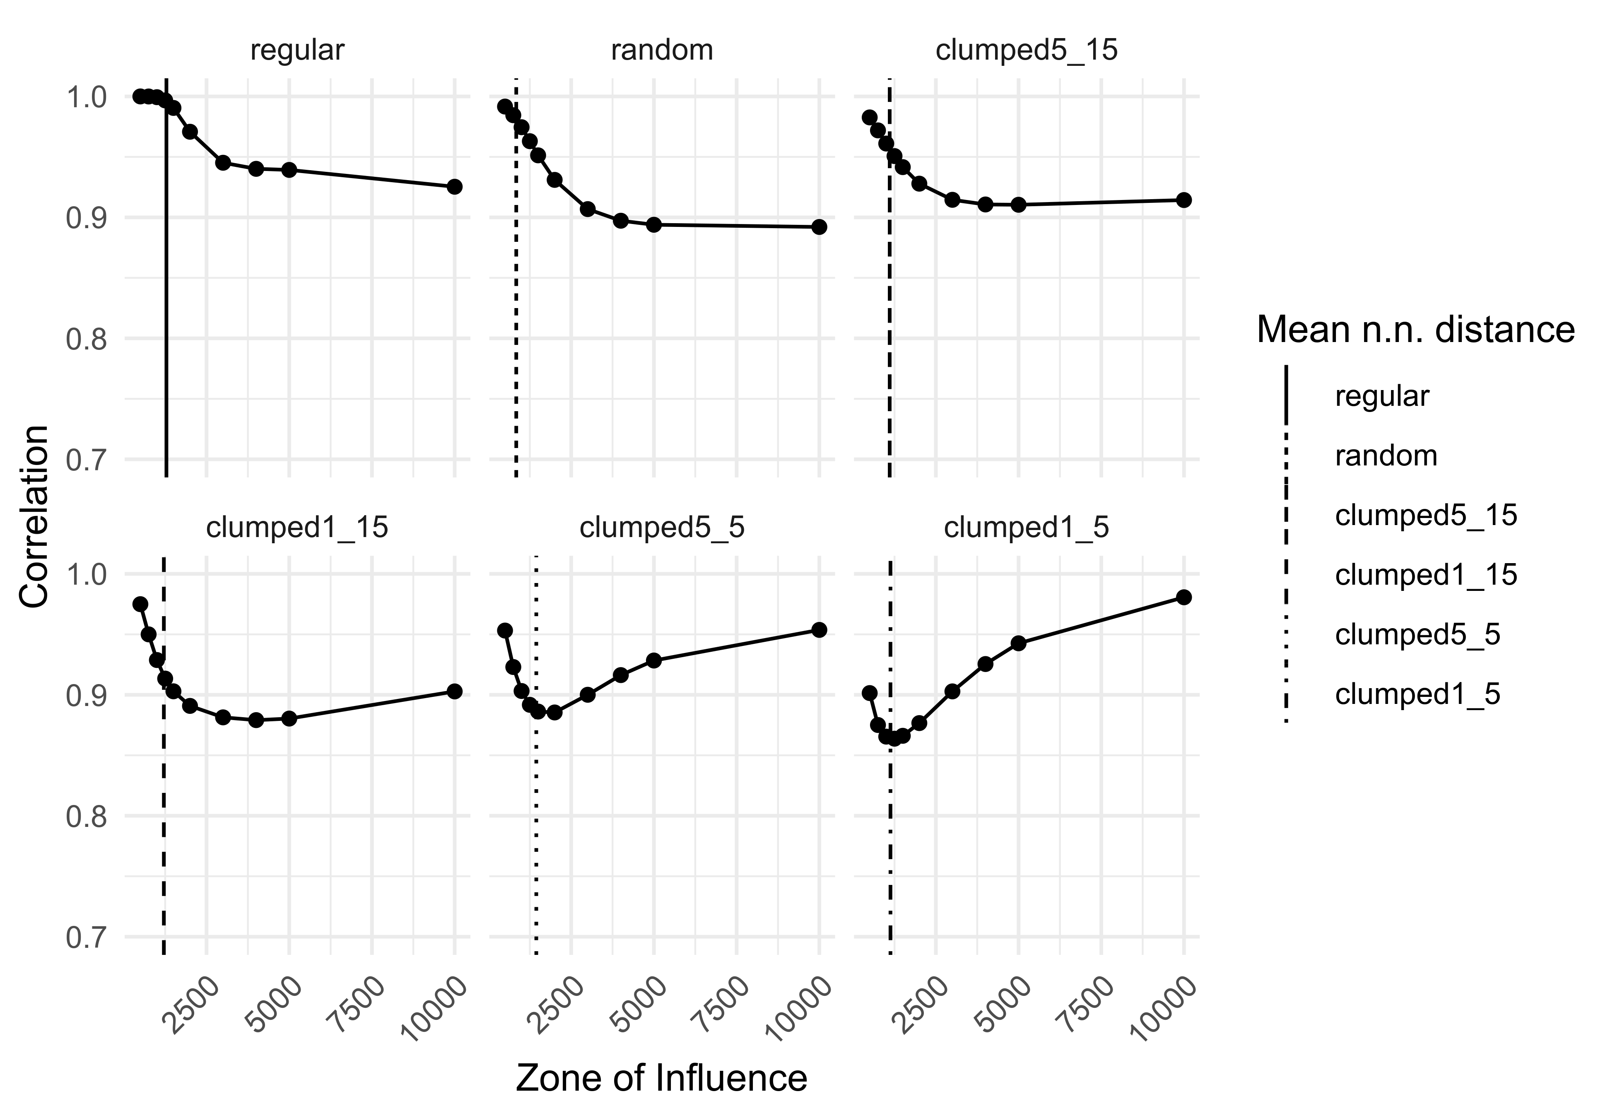
A
B
C
REGULAR
CLUSTERED
SINGLE CLUSTER
Nearest Cumulative
Correlation
Zone of Influence

Slide 7

A
B
C
REGULAR
LARGE CLUSTERS
SINGLE SMALL CLUSTER
Nearest Cumulative
Correlation
Zone of Influence

Slide 8
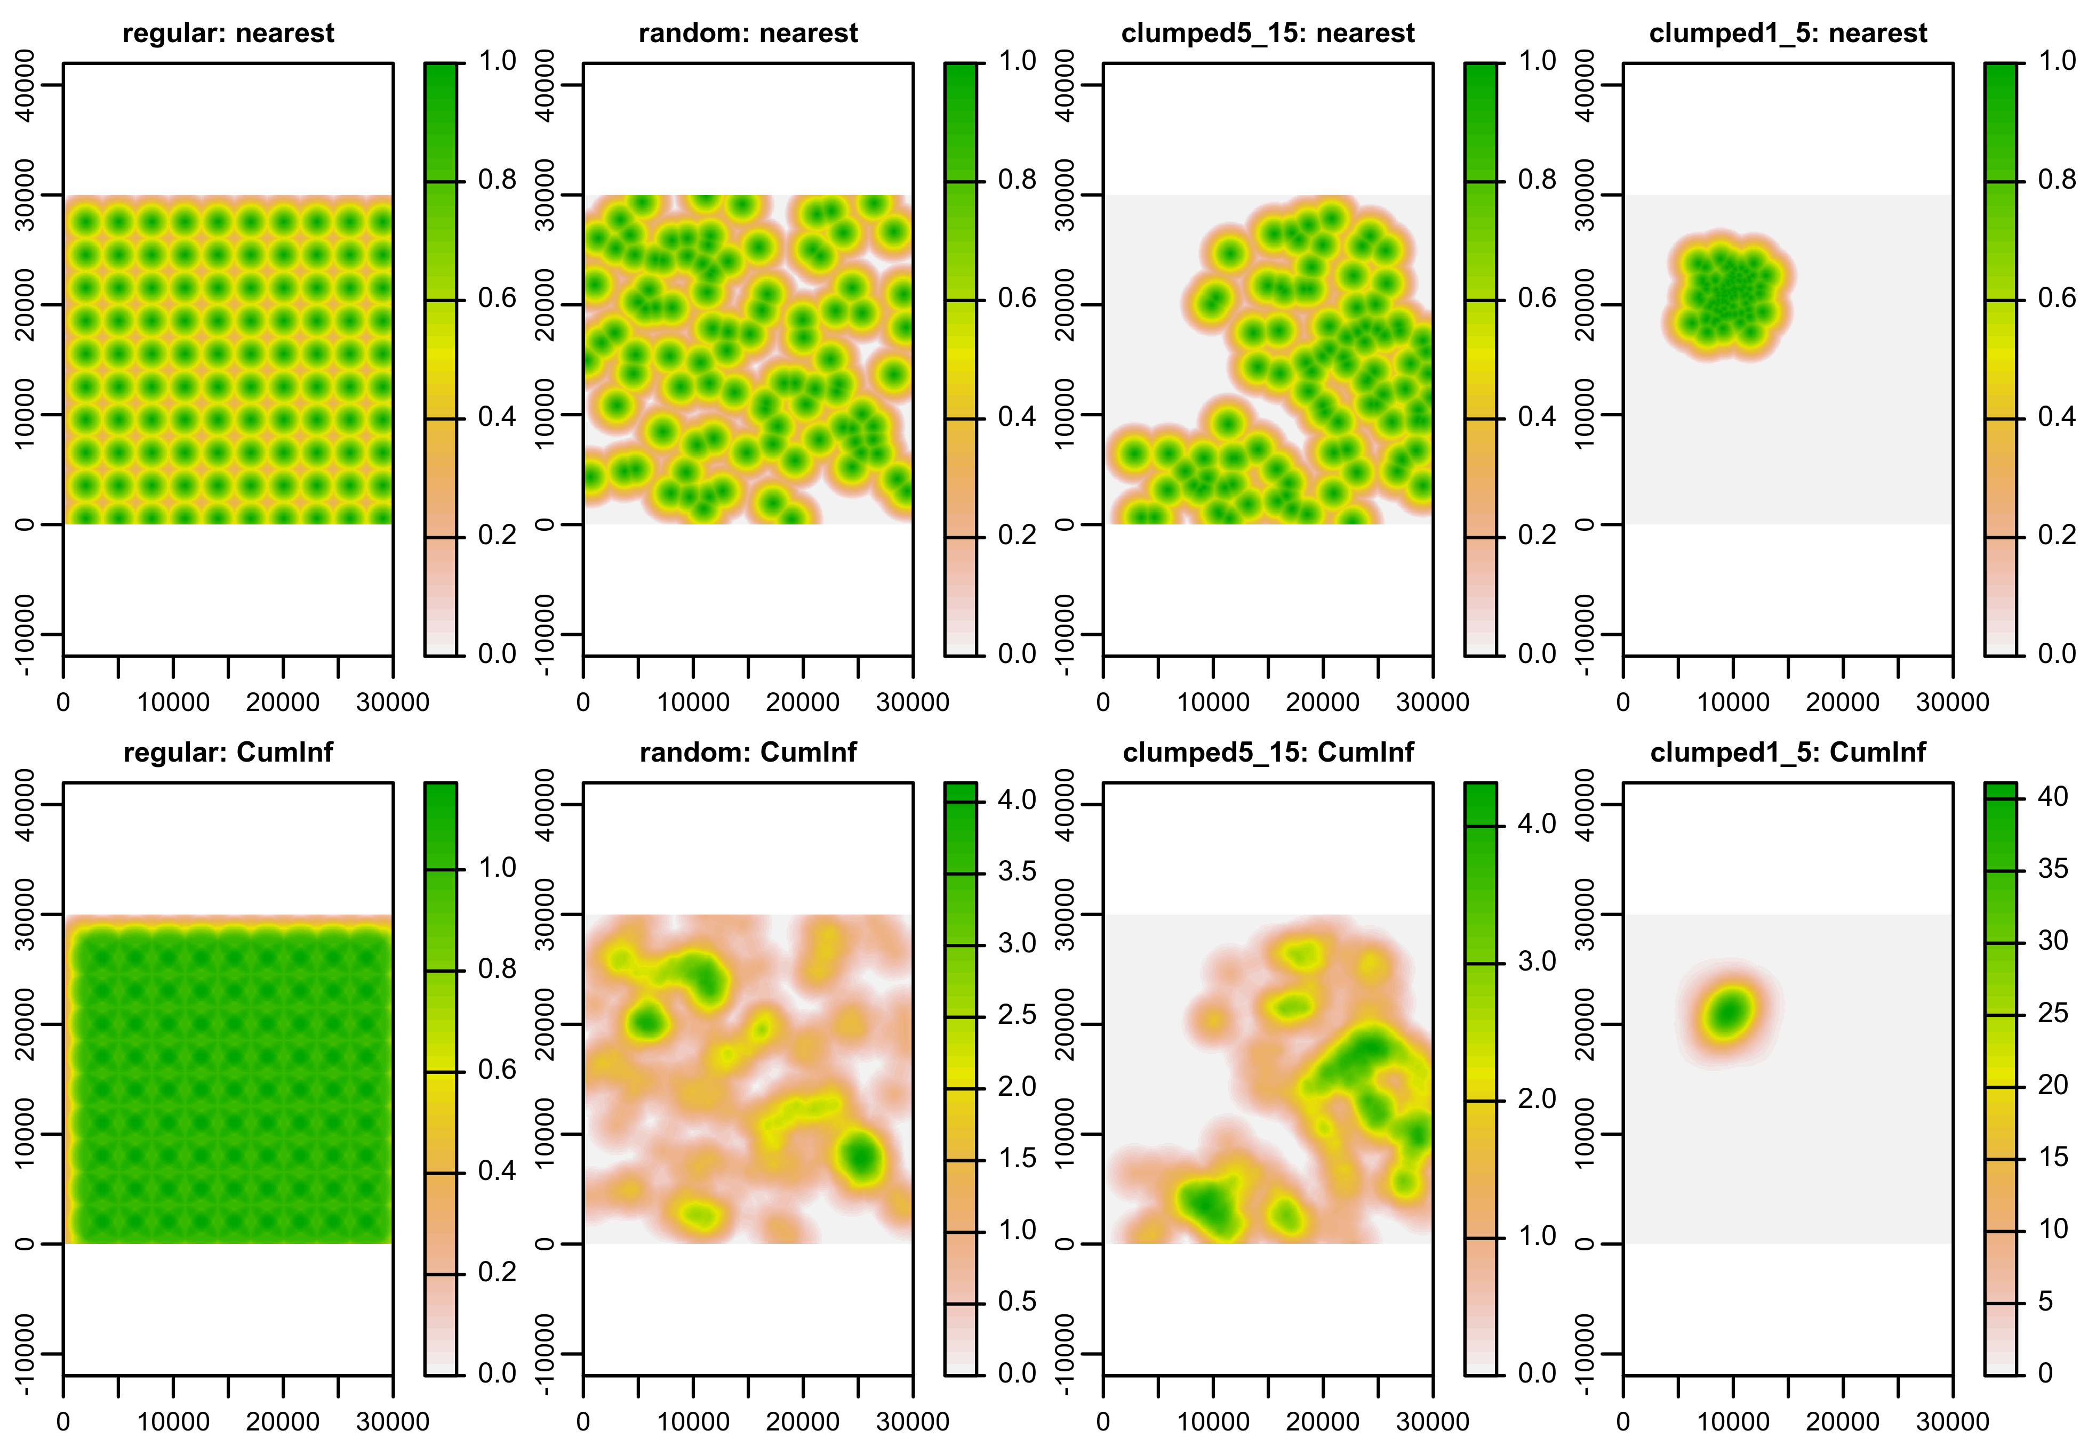
A
B
C
REGULAR
LARGE CLUSTERS
SINGLE SMALL CLUSTER
Nearest Cumulative
Correlation
Zone of Influence

Slide 9
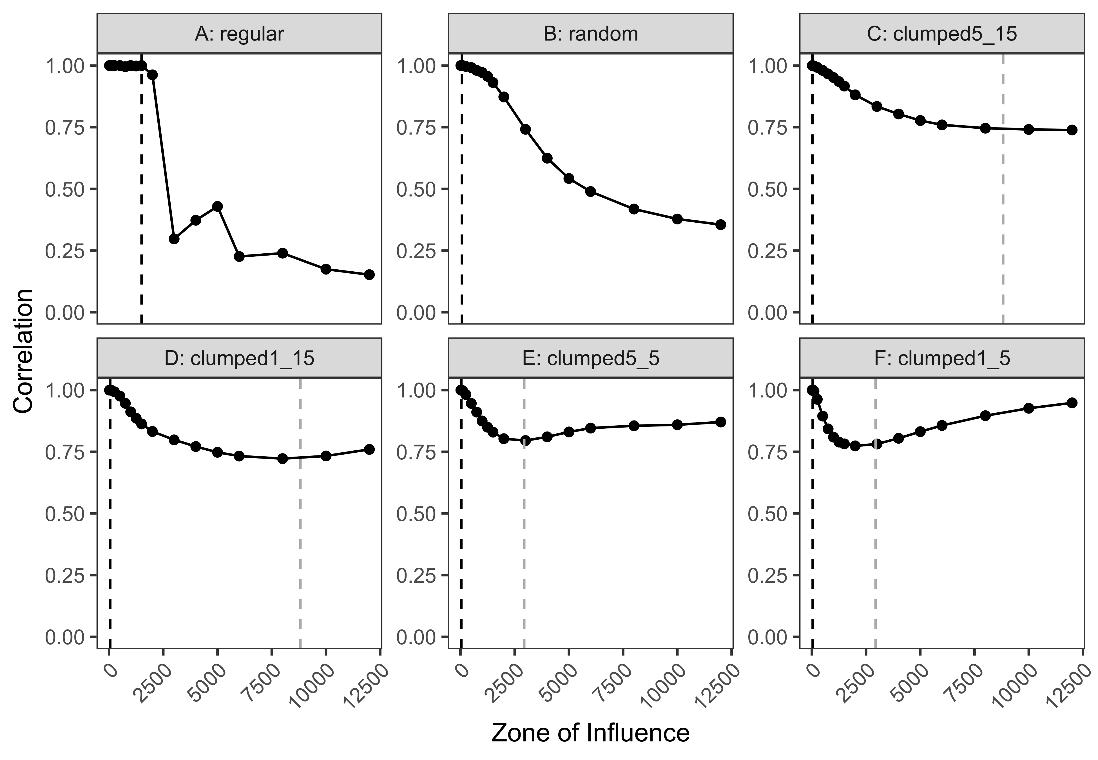
A
B
C
REGULAR
LARGE CLUSTERS
SINGLE SMALL CLUSTER
Nearest Cumulative
Correlation
Zone of Influence

Slide 10
A
B
C
RANDOM
LARGE CLUSTERS
SINGLE SMALL CLUSTER
Nearest Cumulative
Correlation
Zone of Influence

